Slide 1
Milestone 3
User Study
DisCourse:
A flexible platform to talk about course selection
Team 14 | Hazel Dunn, Matthew Chandra, Nicole Pupp, Seraphina Yong, Kimney Nguyen
Notes:
We are Team 14 and our app is DisCourse, a flexible platform for talking about course selection.

Slide 2
Our App Idea
Create a course-reviewing platform that fulfills student needs. The current standard, Rate My Professor, is not geared towards planning courses.
Notes:
(~30 seconds) - Matt
Our project idea was to create an app for sharing reviews and information about courses that better supports students’ needs in choosing classes.
The currently most popular platform similar to this is Rate My Professor, which is centered around professors and may not be the most supportive of actually planning for what classes to take.

Slide 3
User Research Key Findings & Design Ideas
Provide motivation for review writing
See enough useful reviews
Have prompts during review writing so reviewers include information people want to see
See important info in each reviews
Understand the person writing the review
Implementing a profile system for reviewers
Have better idea what the numbers mean
Breaking down the quantitative ratings
Notes:
Matt (1 min)
Before designing, we did user research to learn more about the process of how students choose classes and what they wanted from course reviews.
Our main findings were that people wanted to:
See enough reviews for it to be useful
See specific information in the reviews
Understand the context of the person writing the review
And have a better idea of what the quantitative class ratings meant
So to satisfy these requirements, we came up with several design ideas, namely:
Providing motivation for review writing with achievements and badges
Giving specific prompts in the review writing process to help people write the information readers want to see
Enable profile creation for review writers to give more context about themselves
And have breakdowns and meta-statistics of quantitative ratings

Slide 4
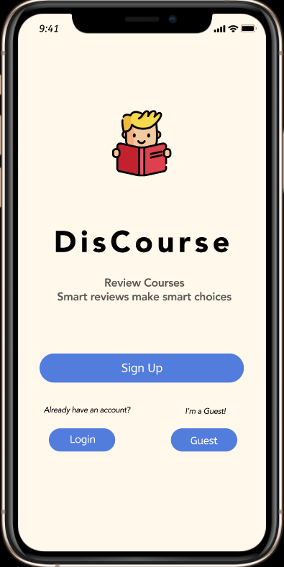
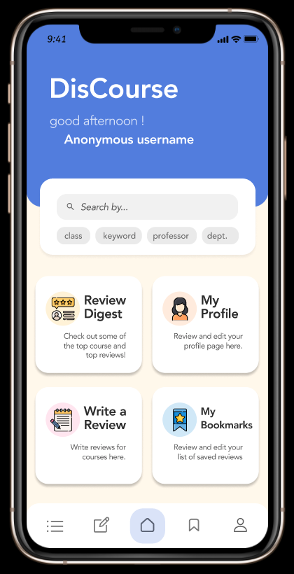
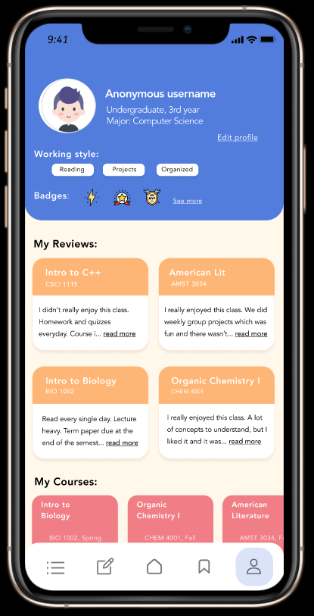
Prototype
Profile Creation
Homepage/Nav Bar
User Profile
Notes:
Kimney
Before getting into our user testing research we wanted to give an overview of our high-fidelity prototype.
When initially opening the app, the user will be directed to either login with their profile, continue as a guest, or go through the sign up process if they are new to the app.
From the sign up, they’re directed to the homepage which presents the main features of the app. A nav bar is also present to allow easy access to these features.
We have included a user profile page, which displays their background information, review history, and badges.

Slide 5
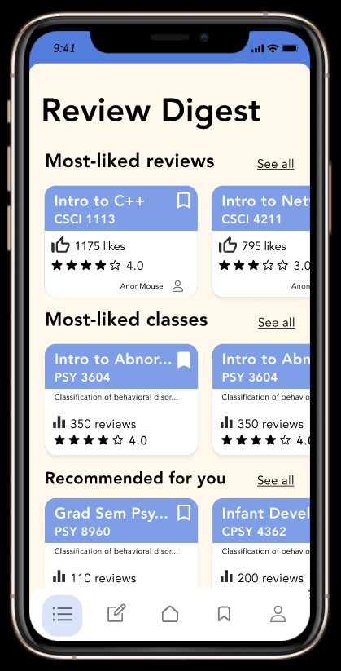
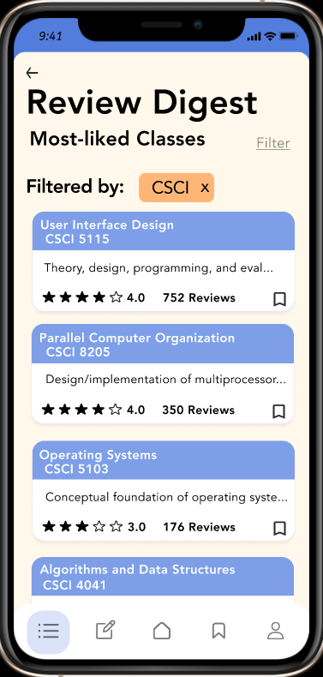
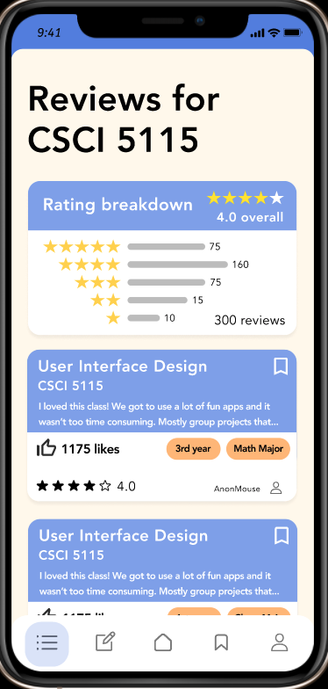
Prototype
Review Digest
Filtering Classes
Rating Breakdown
Notes:
Kimney
Moving on to the review digest feature, users can browse reviews that are highly rated or recommended for them. They can also filter these reviews to view more specific content.

Slide 6
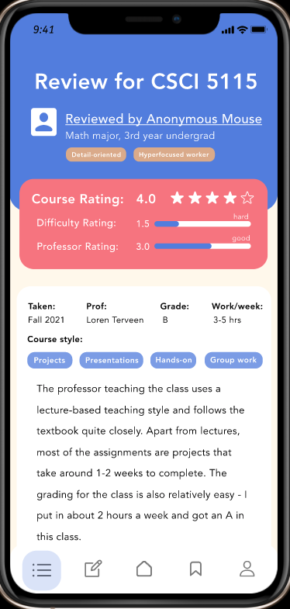
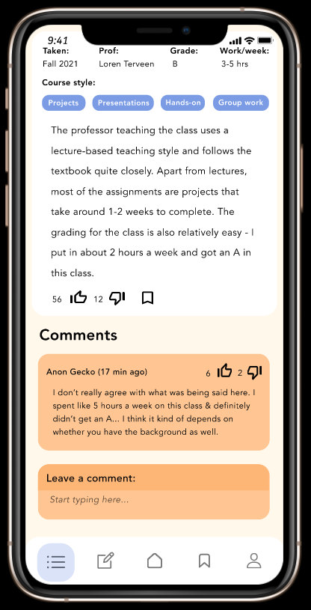
Prototype
A user’s review
Commenting / Upvoting
Notes:
Hazel
When selecting a specific review, the user has access to the review information as well as the reviewer’s background to give more context about the review. They also have the ability to leave comments and upvote or downvote other comments.

Slide 7
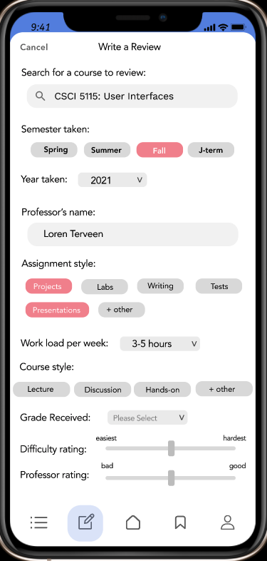
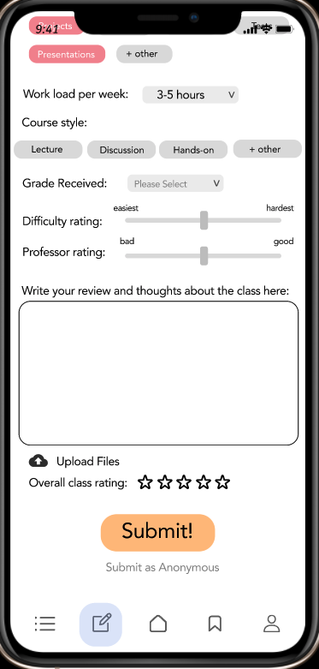
Prototype
Writing a Review
Notes:
Hazel
If a user chooses to write a review, they will be guided through selectable prompts to make the review writing process easier and provide important information for the review.

Slide 8
User Study
Results
Notes:
Hazel
Next, we will talk about our user study results.

Slide 9
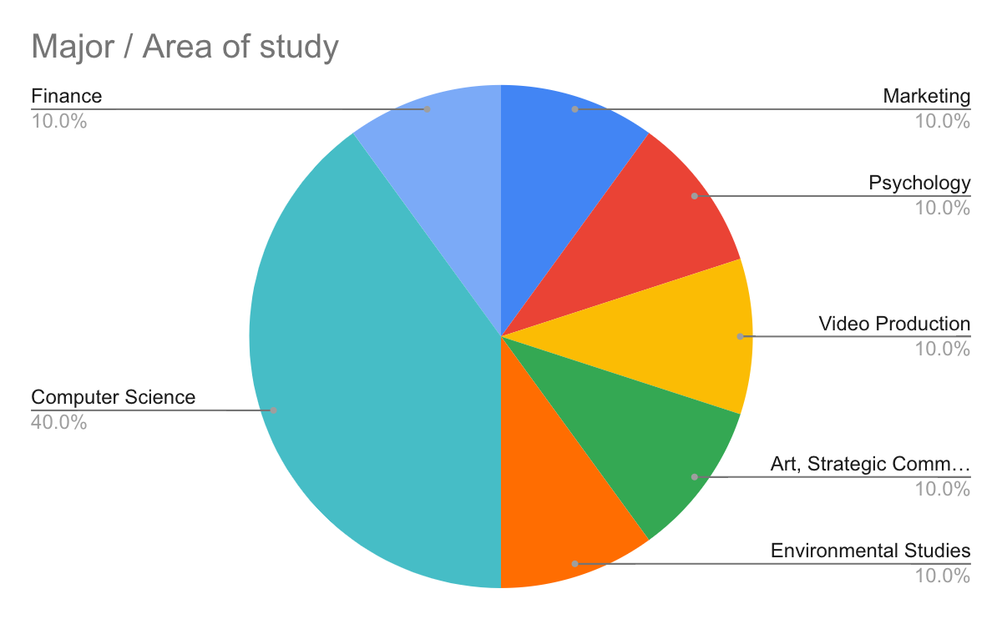
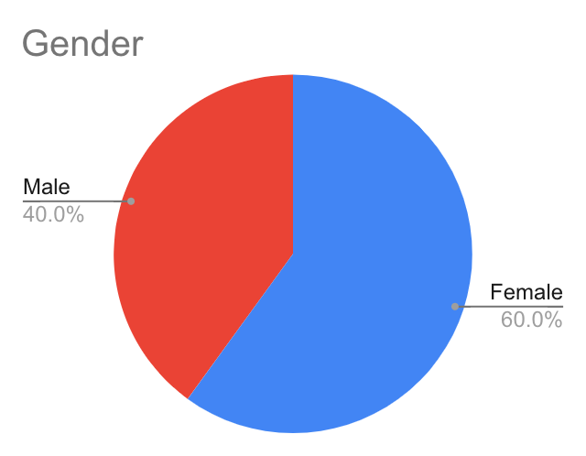
Participant Demographics
The majority (80%) of our 10 participants were 3rd or 4th year undergraduate students
All 10 participants had experience using Rate My Professor
Notes:
Hazel ~30s
In our user studies, we interviewed and observed 10 participants. All of our participants were undergraduate students, and 80% were in their last two years of study. 40% of our participants were studying computer science, while the rest ranged from Marketing to Art.
60% of our users were female, and all of the participants had used rate my professor before.
Include charts for gender distribution and major distribution
State that most (80%) of our 10 participants were 3rd or 4th year undergrads
All participants had used Rate My Professor before

Slide 10
User Tasks
Sign up for the DisCourse app and navigate to the badges in user profile.
Navigate to the Review Digest and filter the Most-Liked Classes category for CSCI classes only.
Find and read through a review, comment, and upvote on it.
Write a review for the class CSCI 5115.
Notes:
Seraphina (~22)
To give an overview of our quantitative analysis, we’ll first go over the tasks measured during the study.
The tasks we gave the users were to:
Sign up for the DisCourse app and navigate to the badges in their profile
Navigate to our Review Digest and filter classes for a specific category
Read a review and comment on it
Write a review for a specific class

Slide 11
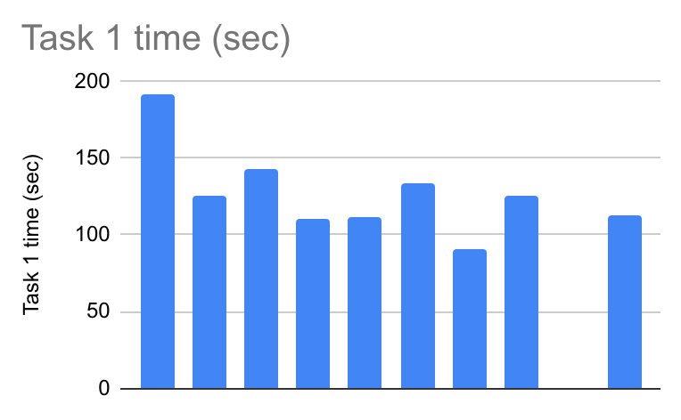
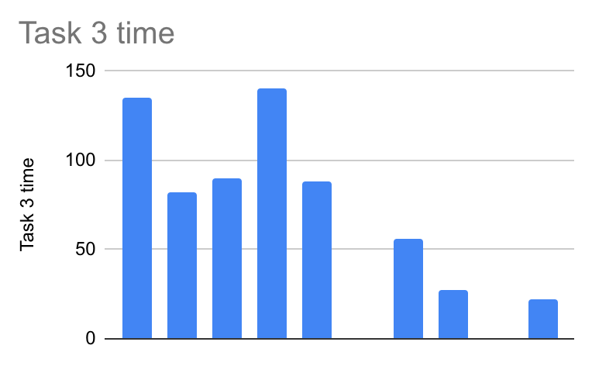
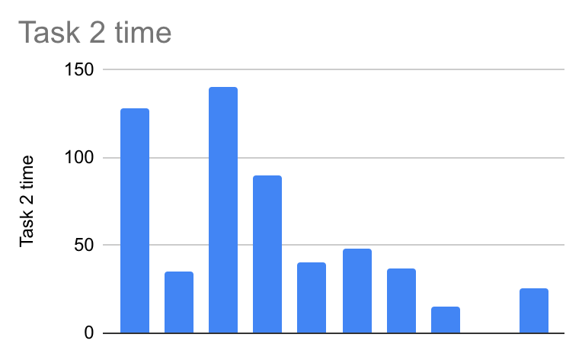
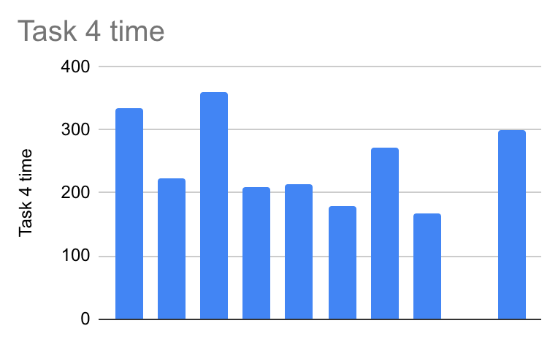
Measurement
Task time
Errors
Frequency
Categorized
Think aloud
(1) Profile Sign Up
(3) Read, Interact with a Review
(2) Review Digest and Filter
(4) Writing a Review
Notes:
Seraphina
We measured the time users took to do each task, then counted and categorized what errors were made for users who took longer to complete the task.
Because we also used think aloud in our study, some of the longer times are due to talking and not necessarily errors.
And few of our task time data points here are missing due to corruption of the data for certain participants.

Slide 12
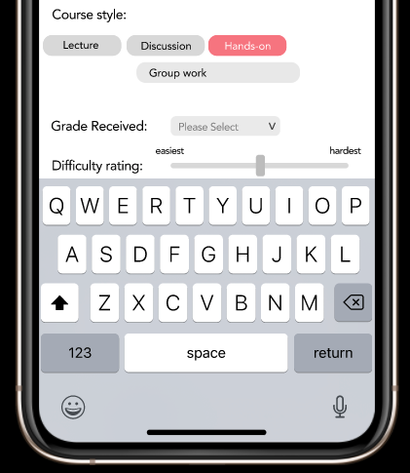
Task time (seconds)
Profile Sign Up
Read, Interact with a Review
Reviews
Review Digest and Filter
Writing a Review
Classes
Notes:
Seraphina
We found that the following errors were more common across participants:
There was confusion about which bubbles in the Review Digest were reviews and which were classes, which caused errors during review digest navigation
When reading a review, some people struggled to recognize the comments section, as the subject of the comments seemed vague to them
And while writing a review, users accustomed to Android input methods struggled with our keyboard and dropdown menu, which was built for iOS.
People also made errors when they expected the review writing feature to be linked to the class they planned to write a review for, when we actually had it linked separately in the nav bar, because they would go back to the Review Digest to write a review.
But generally, none of the users struggled with our signup process or the class filtering.

Slide 13
Qualitative Results
Advantages of DisCourse
Areas of Struggle
Participants found the Review Digest most useful for finding information about courses
Rating breakdown for class reviews
Filtering reviews
App colors are compelling and motivate use of the app
Users enjoyed not having to think as hard while writing a review, by using the prompts
Navigation bar icon for the Review Digest
Too much uniformity in interface design led to confusion on the meaning of certain sections of the app
Comments section in review
Reviews vs. classes in Review Digest
Unable to navigate to previous pages
Notes:
Seraphina
After reviewing our combined qualitative results from the think-aloud and interviews, we found the following points were brought up by multiple users:
They really liked being able to browse and filter a wide range of topics from the Review Digest, and expressed that they would want to use something like this.
They also found the rating breakdown feature to be useful for getting an idea of the rating distribution
User also reported clean and energetic app design motivated them to actually use it
And enjoyed not having to think as hard while writing a review, (which really achieves our initial goal of trying to decrease the effort required to do so)
Things users struggled with included recognizing the nav bar icon for the Review Digest, which looked too similar to a menu icon
Confusion due to too much uniformity in the interface design, (such as the comments section and the reviews and classes in the Review Digest)
And the lack of a back button. They wanted to navigate to previous pages in order to do things like survey a greater breadth of reviews, which you might want to do if you’re looking for new classes to take
They wished the app could have more features such as user-specific filtering options and more information about professors.
Next, we will present a summary of the more key insights we selected, from which we can more fundamentally improve the app design.

Slide 14
Meaningful insights for future work
Provide more page linking
Users attempted to return to class page to write a review
Attempting to return to pages for more info
Accommodate for native device differences
In writing a review, Android users were confused by the iOS style of the drop down menu and keyboard interaction we used
More unique features like the Review Digest are hard for new users to recognize
Suggested changes:
A more recognizable and review related icon for the Review Digest in the navbar
Create a short tutorial to introduce features and function of the app
Notes:
Kimney
In analyzing these results we took away 3 key points for potential next steps:
observing that users many times attempted to find a link to writing a review on a class’s page we found that we may need to provide more page linking for easier access.
We also found we may need to accommodate for native device differences as Android users were confused by its iOS style of features like the drop down menu and keyboard.
Also finding that users tended to have difficulty recognizing the function of the review digest, we thought a change in its nav bar icon to a more recognizable and review related icon may help with identification of the page and a short tutorial to introduce new users of the features and function of the app.

Slide 15
Conclusions
Our idea was to create a space for students to find info for easier class selection
With user research and prototype testing, we were able to implement key valuable features and identify issues to solve and improve.
Notes:
So all in all, we started the semester with the goal to create an app that would ease the stress of class selection for students. And through user research and many iterations of prototyping, we were able to find both parts of the app students found most valuable and specific parts to change.

Slide 16
Thanks for listening!
Notes:
So that’s all we have for you today, and thanks for listening!

